Slide 1
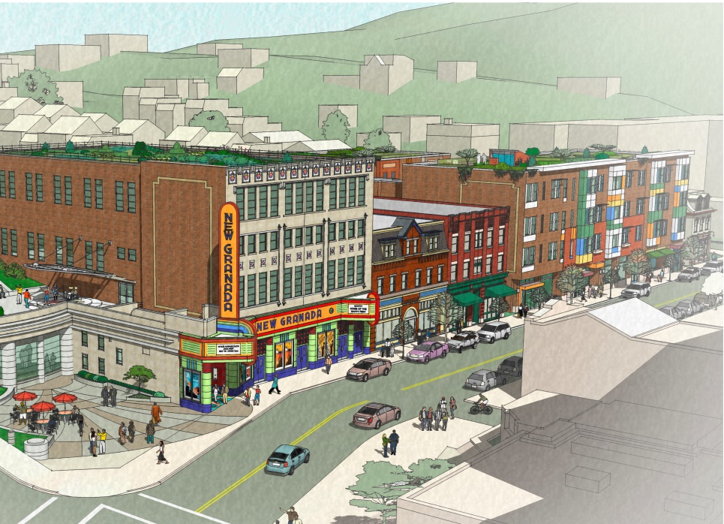

COMMUNITY
COLLABORATION
COMMERCE
CULTURE
Hill District, Pittsburgh PA
Special Community Meeting
March 26, 2019

Slide 2
Welcome

Slide 3
Agenda
Welcome
Regional and Hill District Context
Hill House / Grocery Store Updates
Hill House RFP Process
Presentation
Scoring!

Slide 4
Regional and
Hill District Context

Slide 5
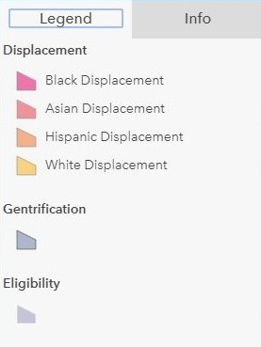
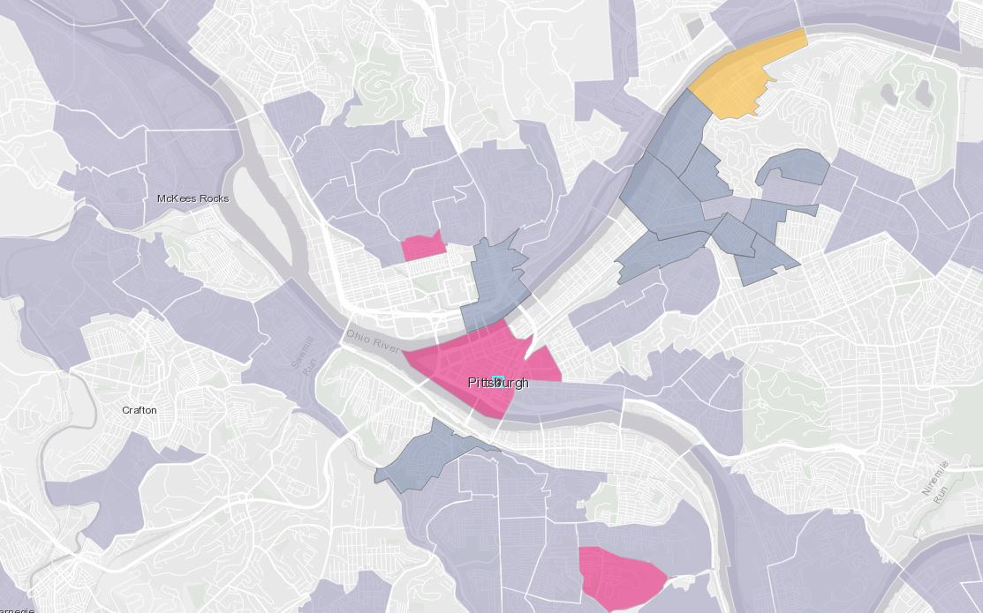
Greater Pittsburgh Region

Slide 6
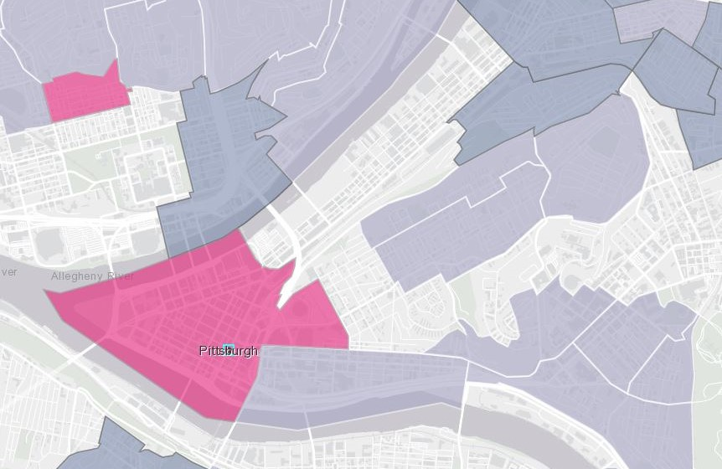
Hill District

Slide 7
How do we preserve culture if we cannot prevent people or our institutions from being displaced?
We must protect the “carriers of culture” if we desire to preserve the culture.
This is a local and national issue!

Slide 8


Slide 9
How will we do it?

Slide 10
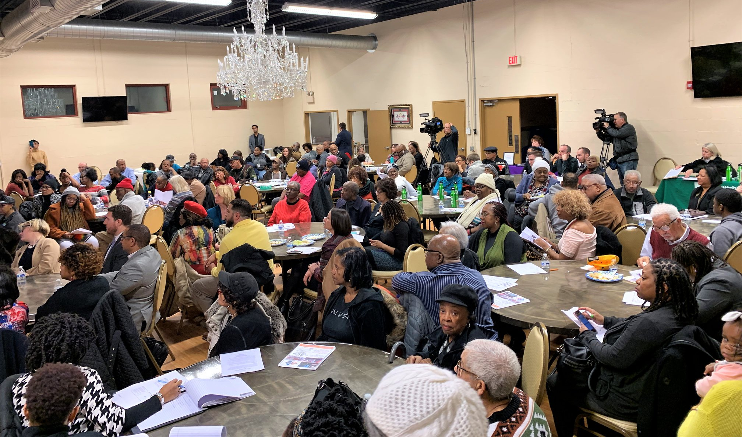
FOLLOW THE MASTER PLAN

Slide 11
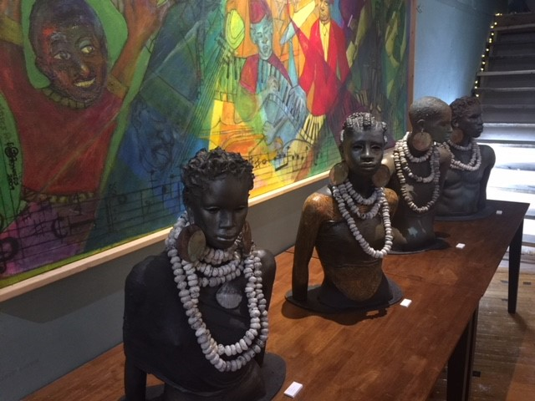

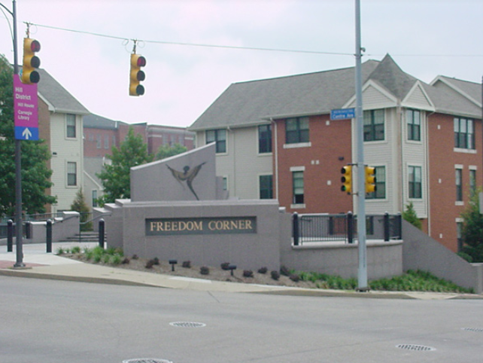
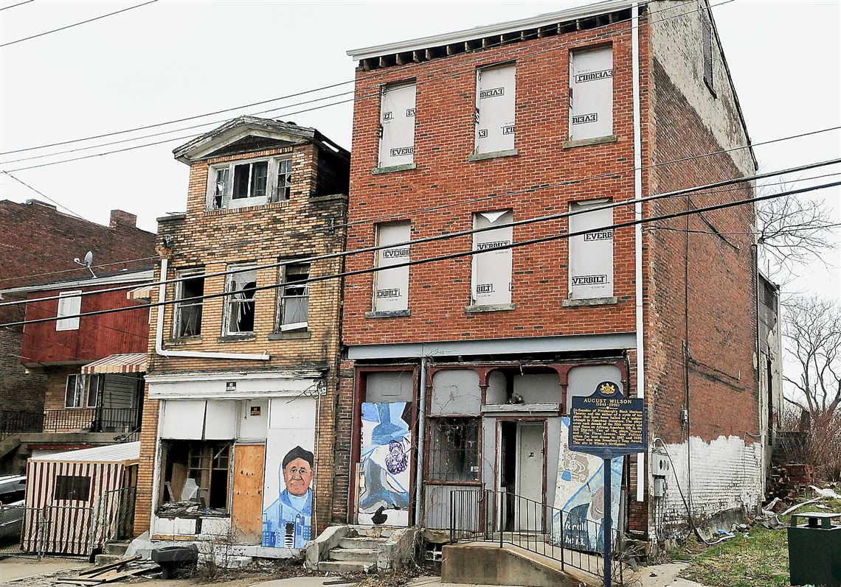
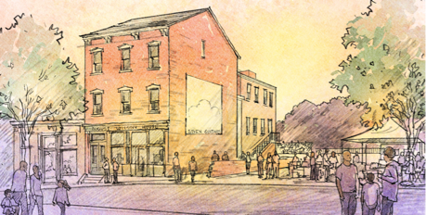
People, Places, Institutions…

Slide 12
Development Principles and
Non-Displacement Strategies
Address/Right Historical Wrongs
Promote Economic Justice
Reflect Neighborhood Driven Civic Design
Promote a Green and Healthy Environment
Utilize Neighborhood Strengths and Assets
Economic Opportunities
Homeowner Support
Renter Support
Preserve Affordability
Community Ownership and Equity

Slide 13
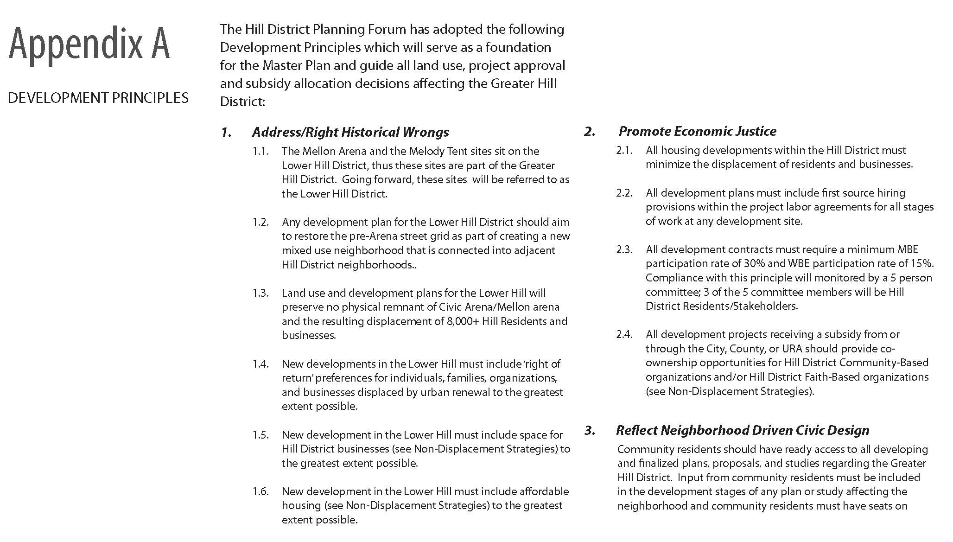
Development Principles

Slide 14
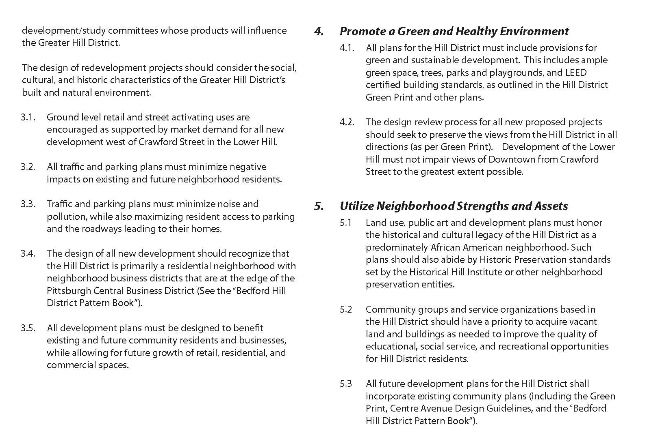
Development Principles

Slide 15
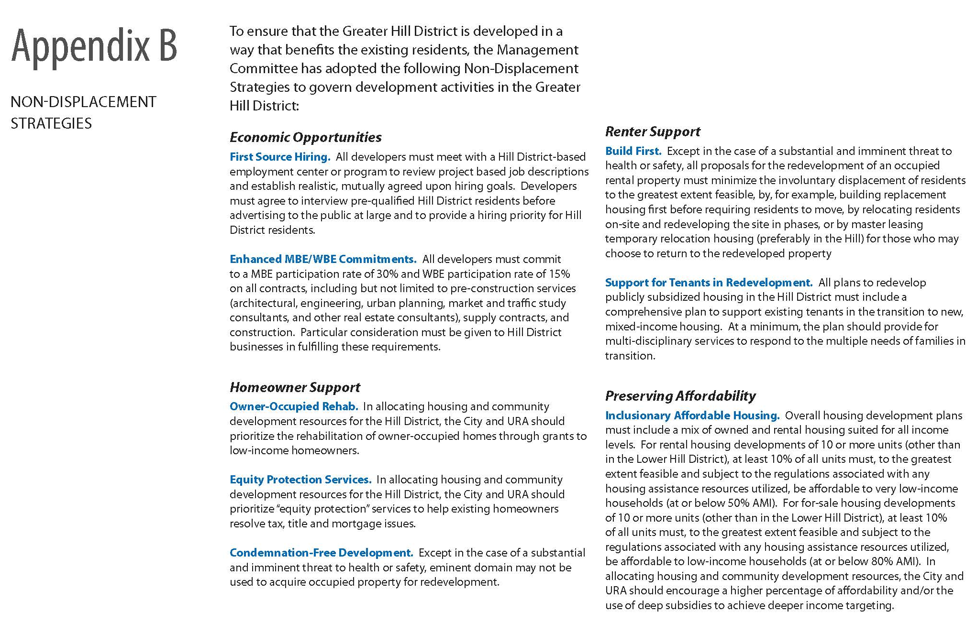
Non-Displacement Strategies

Slide 16
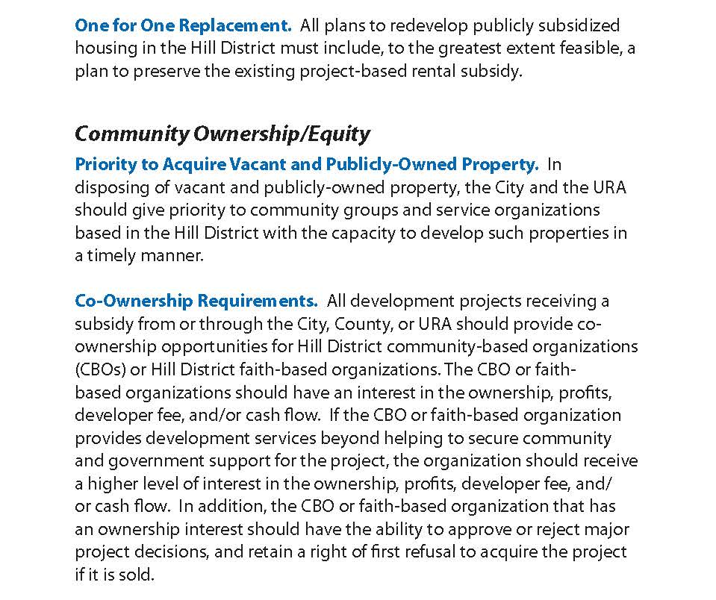
Non-Displacement Strategies

Slide 17
Grocery Store Updates

Slide 18
Grocery Store / Dollar Bank
Dollar Bank and Shop ‘n Save are now CLOSED!
Hill CDC has reached out to two technical support agencies that handle grocery store transitions in food dessert neighborhoods
In discussions with Giant Eagle’s Curbside Express to potentially start a food delivery service in the Hill District, which can be a good interim solution for food access.
In communication with Councilman Lavelle, Rep. Wheatley and URA to help find new grocer.

Slide 19
Hill House RFP Process
How did we get here?

Slide 20
August – December 2018 – Growth Fund, Elected Officials, and Hill House negotiating MOU and community engagement process
December 2018 – Elected Officials filed a stay to stop the sale of Hill House
January 2019 – MOU between Growth Fund, Elected Officials, & Hill House was signed
Hill House Association started receiving $125K/month from the Growth Fund
January 18th – URA officially released RFP for Hill House properties

Slide 21
Responses originally due Wednesday, February 13th at 2:00 PM
Due Diligence Issues – Developers signed and submitted a letter of complaints about not having proper access to Hill House to complete their bids.
As a result, the RFP Deadline was extended to February 27th at 2:00 PM
Hill House Association was closed from January 21st until 2 weeks ago for reported water issues. Details have not been made available.

Slide 22
Despite extension, URA ultimately only received 2 bids
  1 for One Hope Square
  1 for all 4 properties
Proposals presented to the Development Review Panel (DRP) on March 19th
One proposal received an 80% or higher score at the DRP
Tonight, you will get a presentation of that proposal
The community’s choice is still in your hands, please score accordingly!

Slide 23
Q&A

