Slide 1
1700 FIFTH AVE
DRP PRESENTATION
APRIL 2023
CREATING THRIVING COMMUNITIES

Slide 2
TABLE OF CONTENTS
3
ABOUT ALPHA RESIDENTIAL
7
ABOUT THE PROJECT
11
RENDERINGS AND IMAGES
19
BENEFITS
CONFIDENTIAL
2

Slide 3
ABOUT
ALPHA RESIDENTIAL
CREATING THRIVING COMMUNITIES

Slide 4
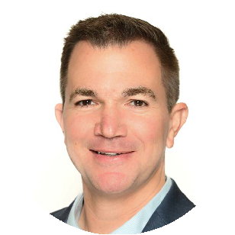
WHO WE ARE
AWARDS
Alpha Residential is a Pittsburgh-based real estate investment firm that acquires, develops, andmanages institutional quality multifamily housing communities.
Alpha’s executives have tailoredexperience in the multifamily sector with comprehensive operating know-how, including assetmanagement, property management, development, repositioning, acquisition, and financing. Alphais a disciplined investment manager with a vertically integrated and tech-enabled real estate platform.We are a leader in our selected targeted markets deploying advanced technology and proprietary analytics to capitalize on market inefficiencies and drive operational performance. We invest incommunities with opportunities to create value throughout the lifecycle, from an attractive entry point, through the execution of a comprehensive business plan and ultimate disposition.
Inc 5000 2x-honoree
2021- #3 in Pittsburgh
2022 -#9 in Pittsburgh
2023 Build Tennessee Merit Award
Apex Marathon Village Project
MISSION
We are on a mission to champion prosperity through disciplined and integrity-driven investment strategies, in order to create thriving communities.
CERTIFICATIONS
LEADERSHIP
Jide Famuagun
CEO
Brandon Kessinger
COO
James Baldwin
General Counsel
Joseph Johnson Managing Director, Development
CONFIDENTIAL
4

Slide 5
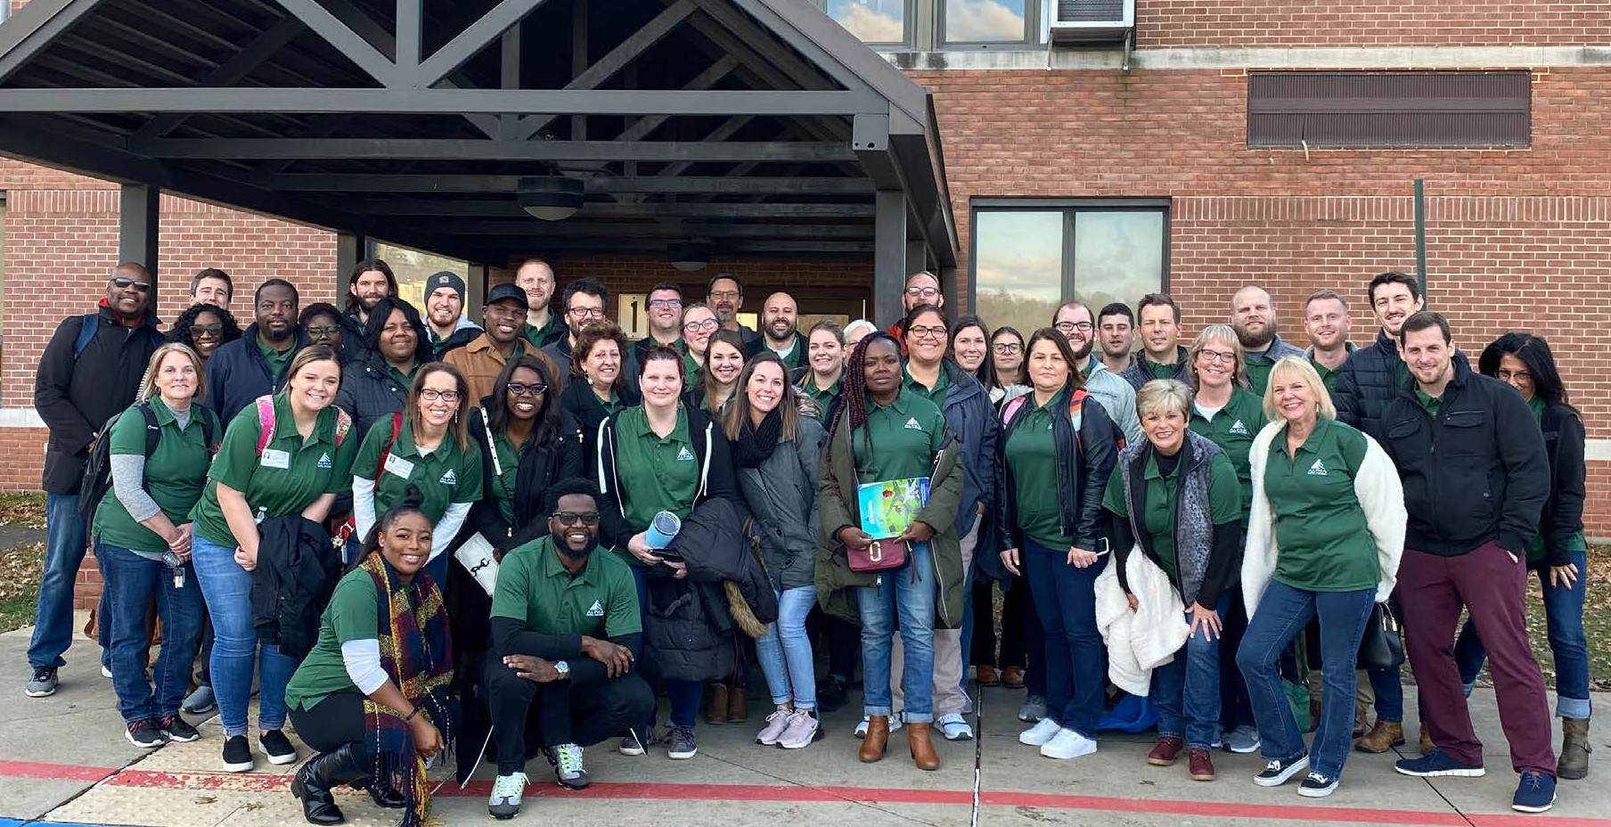
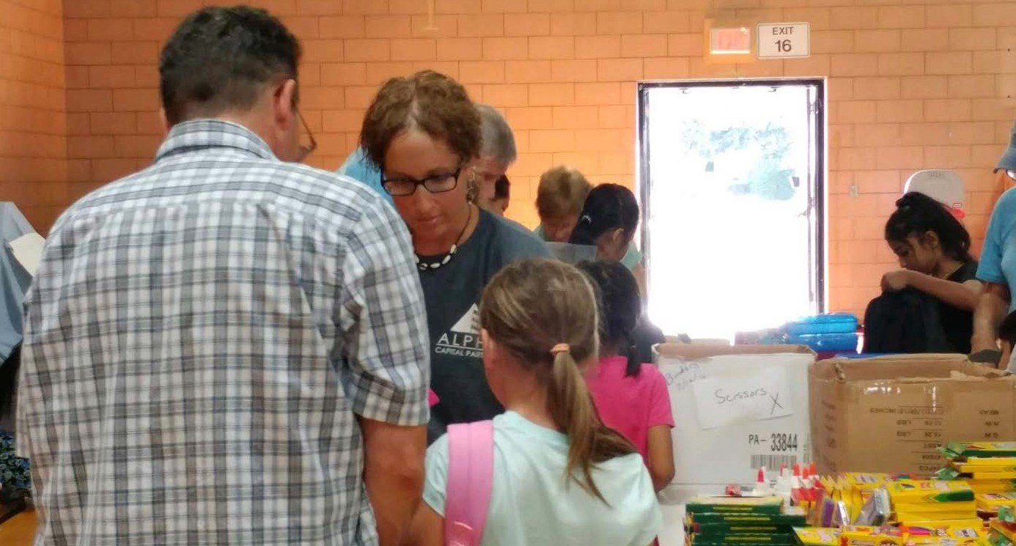
COMMUNITY INVESTMENT
AlphaCares started in 2017. We have partnered with 15 organizations since inception. We have donated $10,000+ to local organizations and 826 employee volunteer hours to date.
Heavily supportive of education initiatives:
Junior Achievement - Chartiers Valley Elementary School, Pittsburgh, PA
Jide Famuagun
Board Member
The Education Partnership
Lawunmi Famuagun
Board Member
South Fayette PTA
South Hills Interfaith Movement (SHIM) Backpack Event
CONFIDENTIAL

Slide 6
DEVELOPMENT PARTNERS
DEVELOPER (MBE) |  | ARCHITECTURE
CIVIL ENGINEER (VBE) | TRAFFIC ENGINEER (WBE) |  | ENVIRONMENTAL CONSULTANT (MBE)
CONTRACTORS & SUBCONTACRTORS | PUBLIC RELATIONS |  | PITTSBURGH-BASED
CONFIDENTIAL

Slide 7
ABOUT THE PROJECT
CREATING THRIVING COMMUNITIES

Slide 8
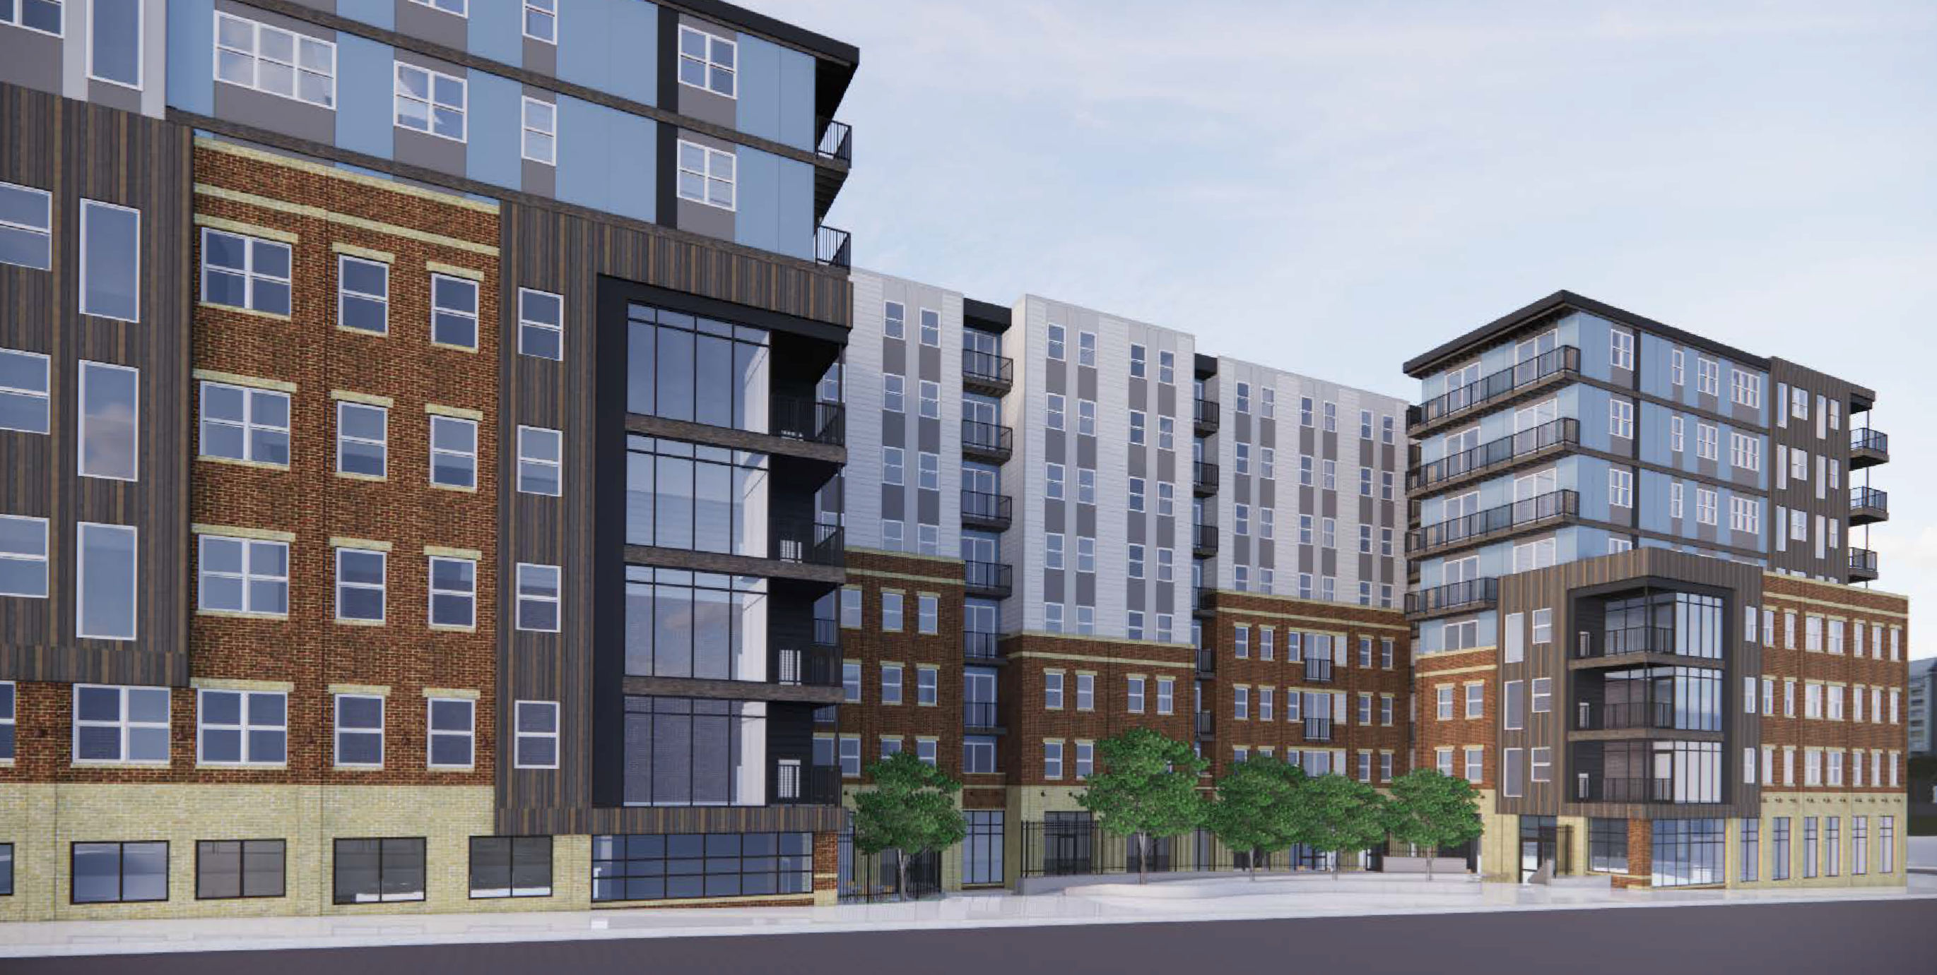
EXECUTIVE SUMMARY
240
Apartment homes including
30 affordable homes
12,000 sq. ft. Ground floor commercial mixed-use space
$75M (est.)
Total development cost
1700 Fifth Avenue
A mixed-use project located within the Hill District’s Uptown Neighborhood.
CONFIDENTIAL

Slide 9
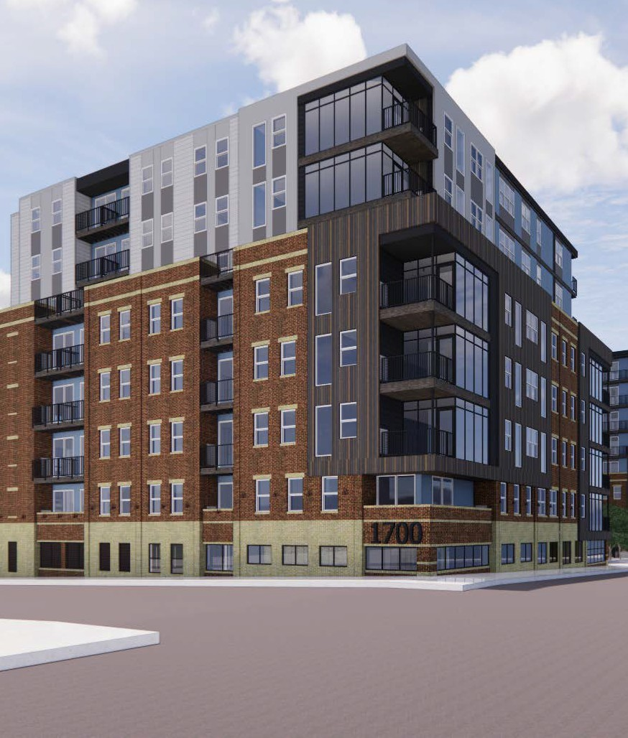
DEVELOPMENT SUMMARY
1700 FIFTH AVE
This project will support the transformation of the city block along 5th Avenue on the new BRT (Bus Rapid Transit) route, and adjacent to over $1 billion of commercial/institutional investment in the new Mercy Hospital and First National Tower and Plaza, all now under construction.
Projected construction start date: March 1, 2024 Projected rent commencement date: September 1, 2025 No one is being displaced.
30
Affordable homes
50-85% AMI
$733-$833/mo
Affordable rental rate
40-50
Full-time equivalent jobs
$75M
Total development cost
CONFIDENTIAL

Slide 10
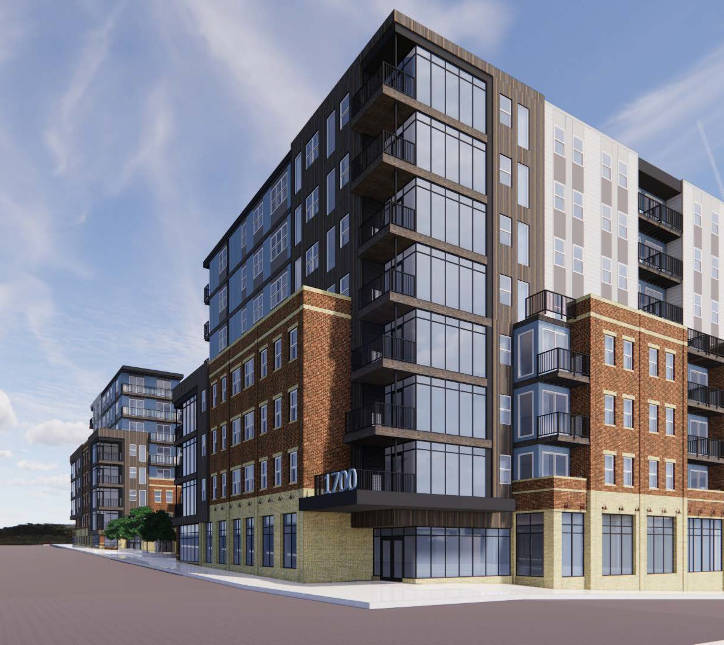
PROPOSED DEVELOPMENT DETAILS
Homes
Studio, 1 BR, and 2 BR
apartment homes
12,000 sq. ft.
commercial mixed-use
6,000 sq. ft.
public plaza
189
structured parking spaces
CONFIDENTIAL

Slide 11
PROJECT DETAILS
This project will be delivered across one multi-story residential building. The property will feature 240 apartments with upscale amenities.
Address (block) | 1700 Fifth Avenue, Pittsburgh PA , 15219
Land Area | .85 acres
Buildings | 280,000 sq ft including parking
Homes | RSF | 240 Units
Retail / Commercial (Mixed-Use) | 12,000 sq ft
Parking Spaces (at and below grade) | 189 Spaces
Structural Framing | Non-combustible flrs 1-3. Wood flrs 4-8.
Exterior Walls | Facade | Masonry, Cementitious, and Metal Panel
Roof | Green Roof
Fire Protection System | Fully Sprinklered
HVAC Residential | Individual Vertical Through-wall Air Conditioning systems
HVAC Common | Packaged Units (RTUs)
Utilities | Individually metered/sub-metered
HOME FEATURES
Ceiling Fans | Tile Backsplash
Private Balconies* | Walk-in Closets*
Solid Surface Countertops | Washer & Dryer*
Stainless Steel Appliances | Wood-style Floors
COMMUNITY AMENITIES
24-hour Maintenance | EV Charging Station
Club Room | Fitness Center & Yoga Room
Controlled Access | Grilling Stations
Carwash Station | Storage
PUBLIC AMENITIES
Bike parking | Public parking
Public Arts | Plaza
Small Event and Meeting spaces
Commercial, Retail, and Restaurant opportunities
*Select units
CONFIDENTIAL

Slide 12
PROJECT RENDERINGS & IMAGES
CREATING THRIVING COMMUNITIES

Slide 13
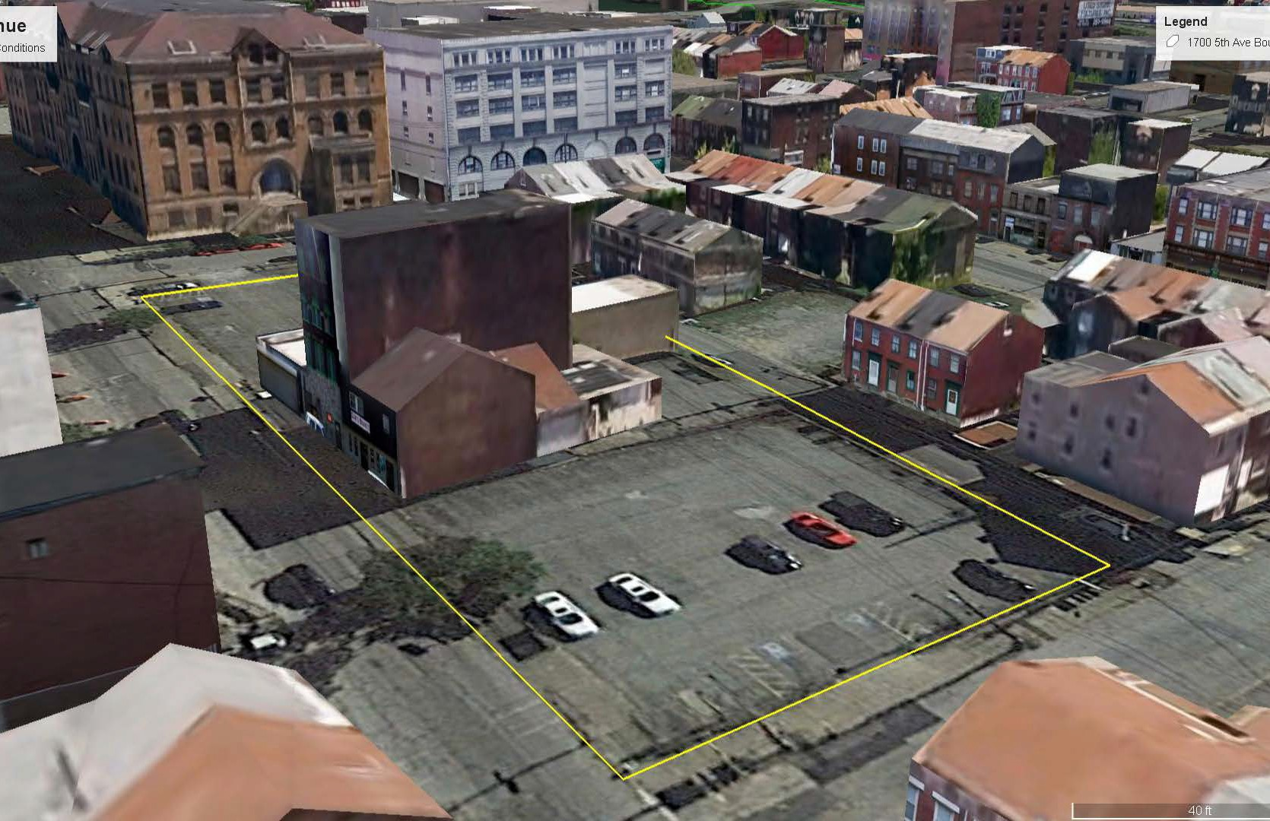
1700 FIFTH AVE - EXISTING CONDITIONS
CONFIDENTIAL

Slide 14
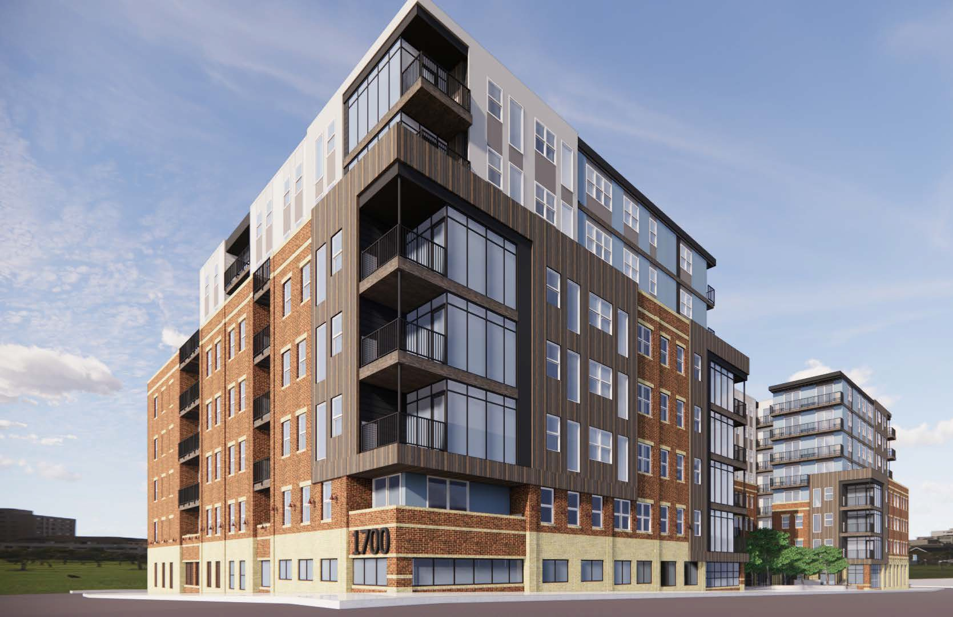
FIFTH AVENUE & MILTENBERGER
CONFIDENTIAL

Slide 15
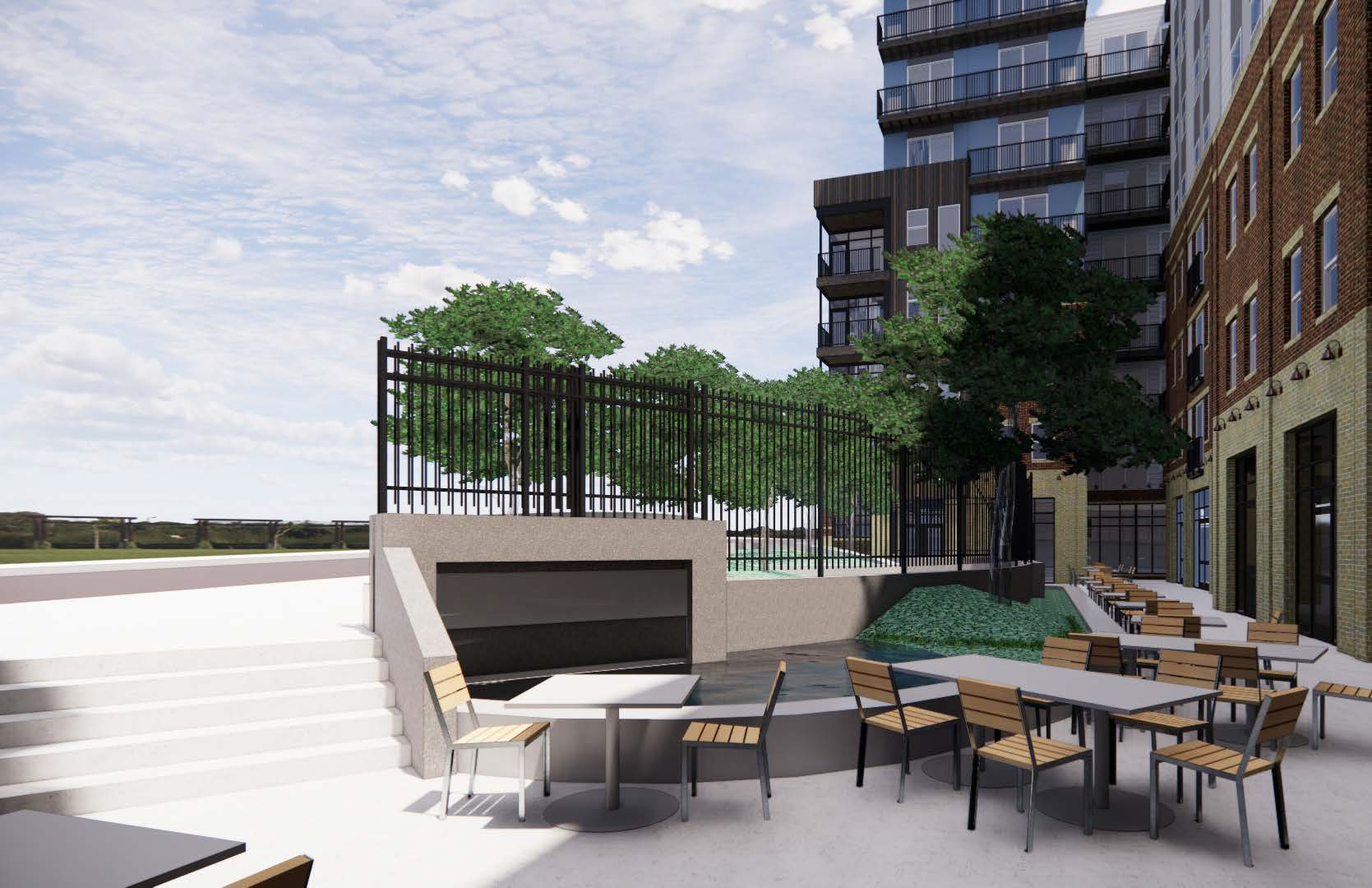
PROPOSED PUBLIC PLAZA
CONFIDENTIAL

Slide 16
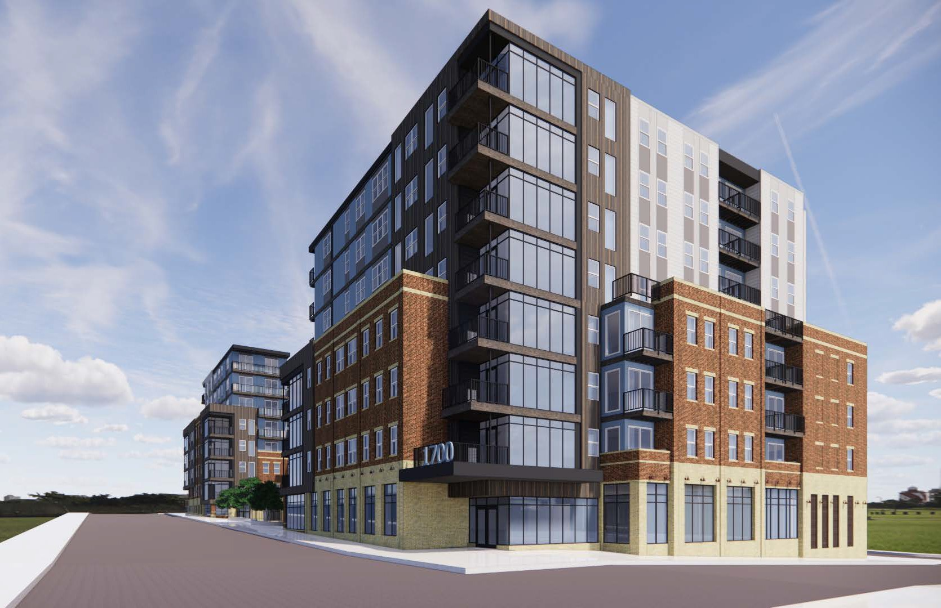
FIFTH AVENUE & VAN BRAAM
CONFIDENTIAL

Slide 17
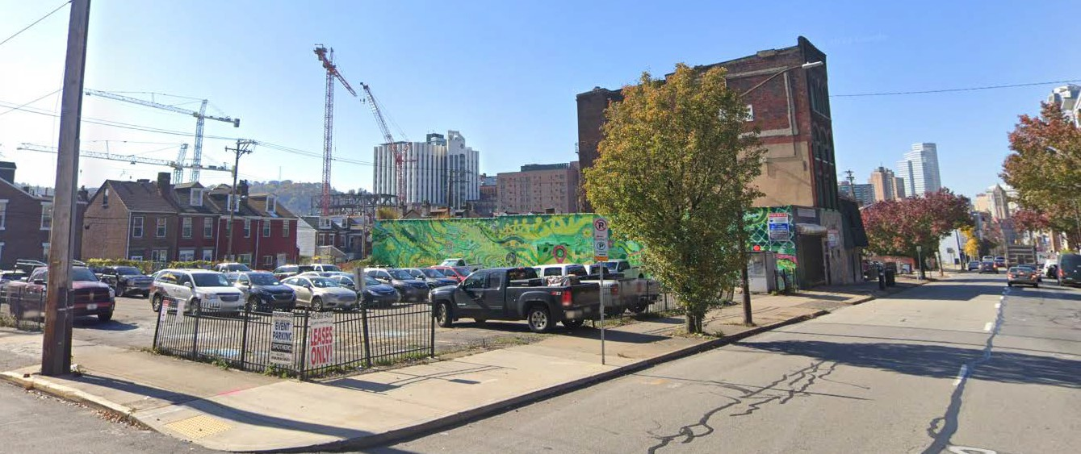
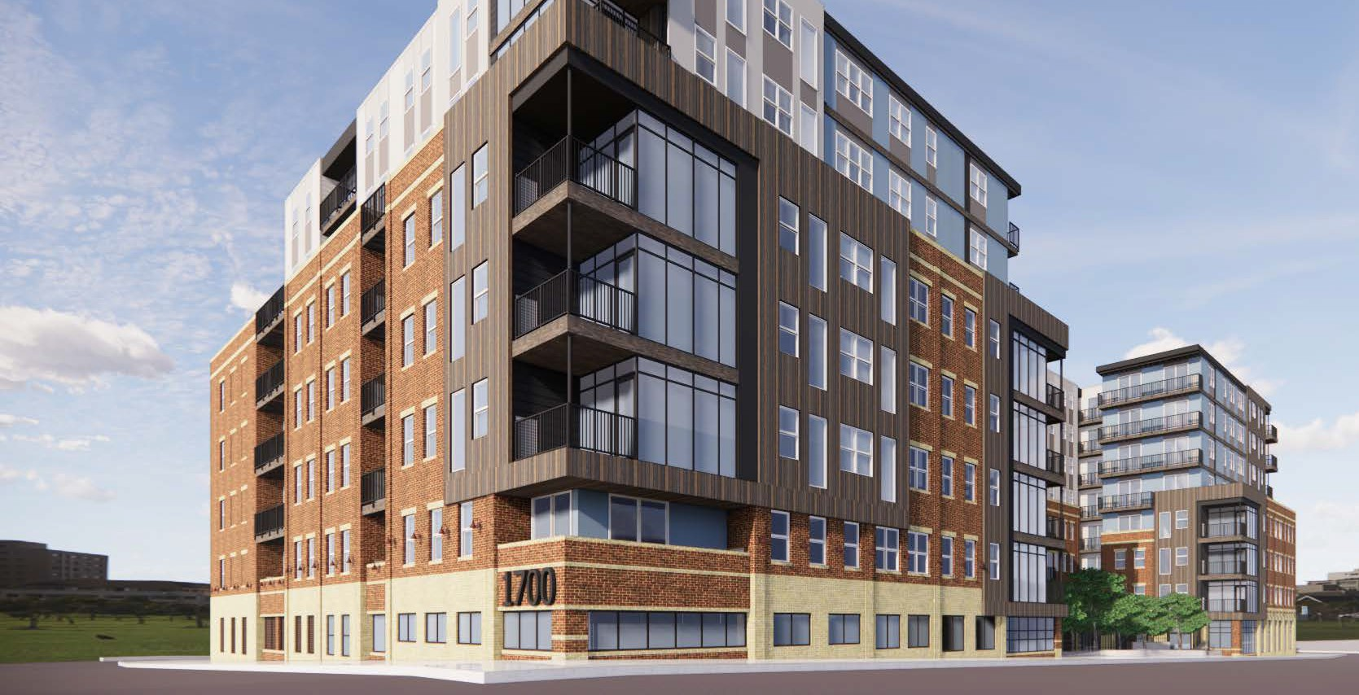
FIFTH AVENUE & MILTENBERGER
Existing
Future
CONFIDENTIAL

Slide 18
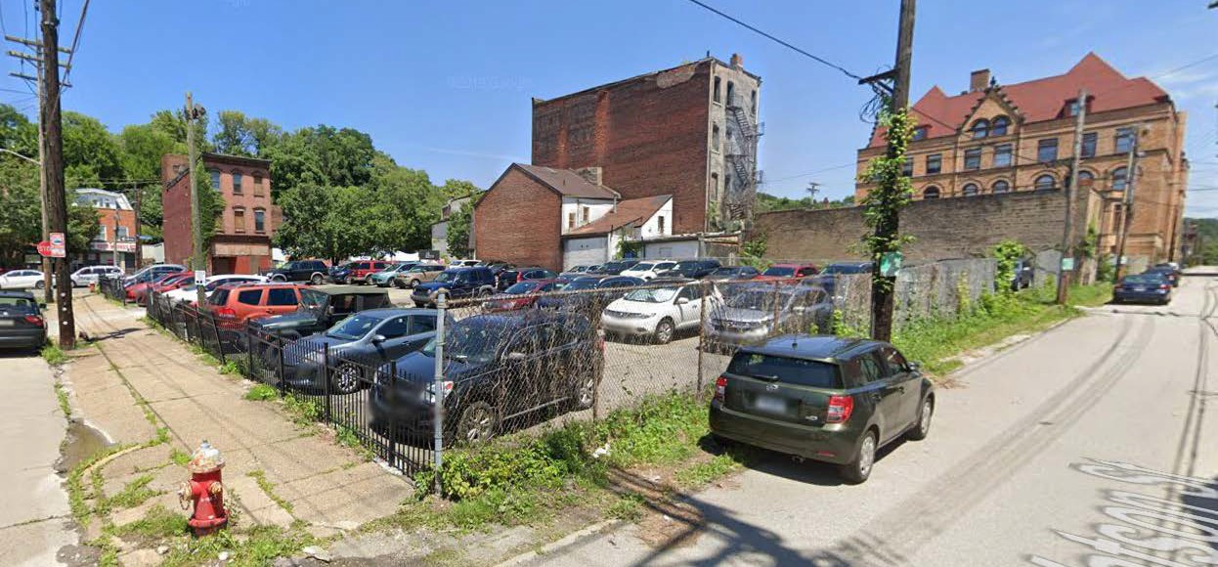
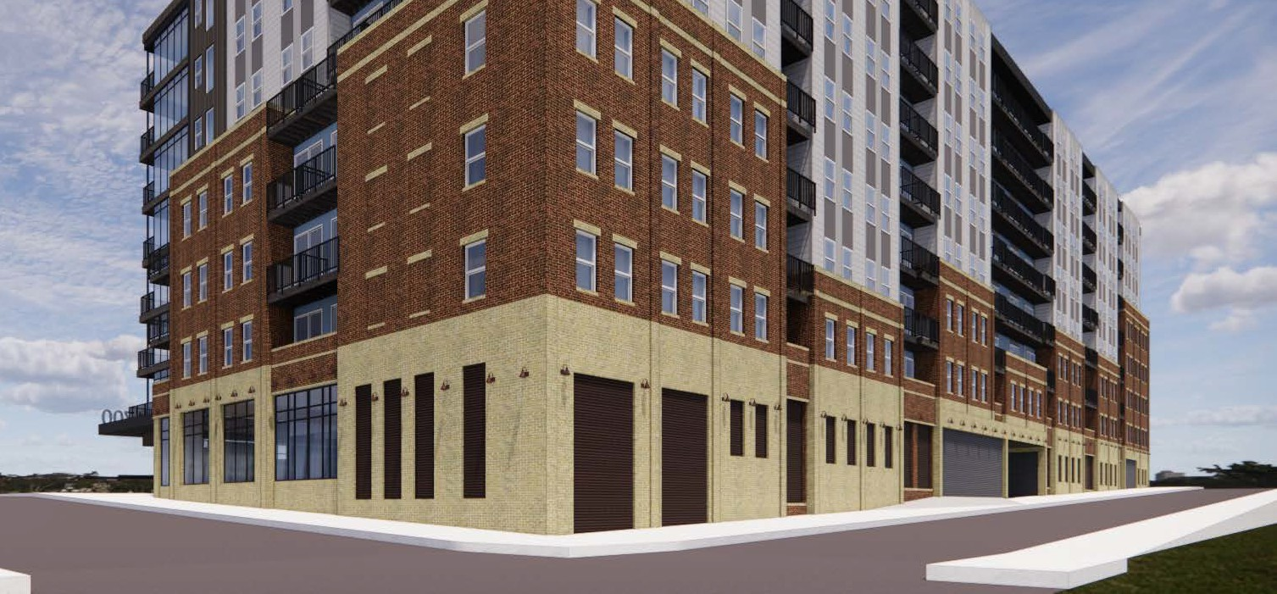
Existing
VAN BRAAM & WATSON
Future
CONFIDENTIAL

Slide 19
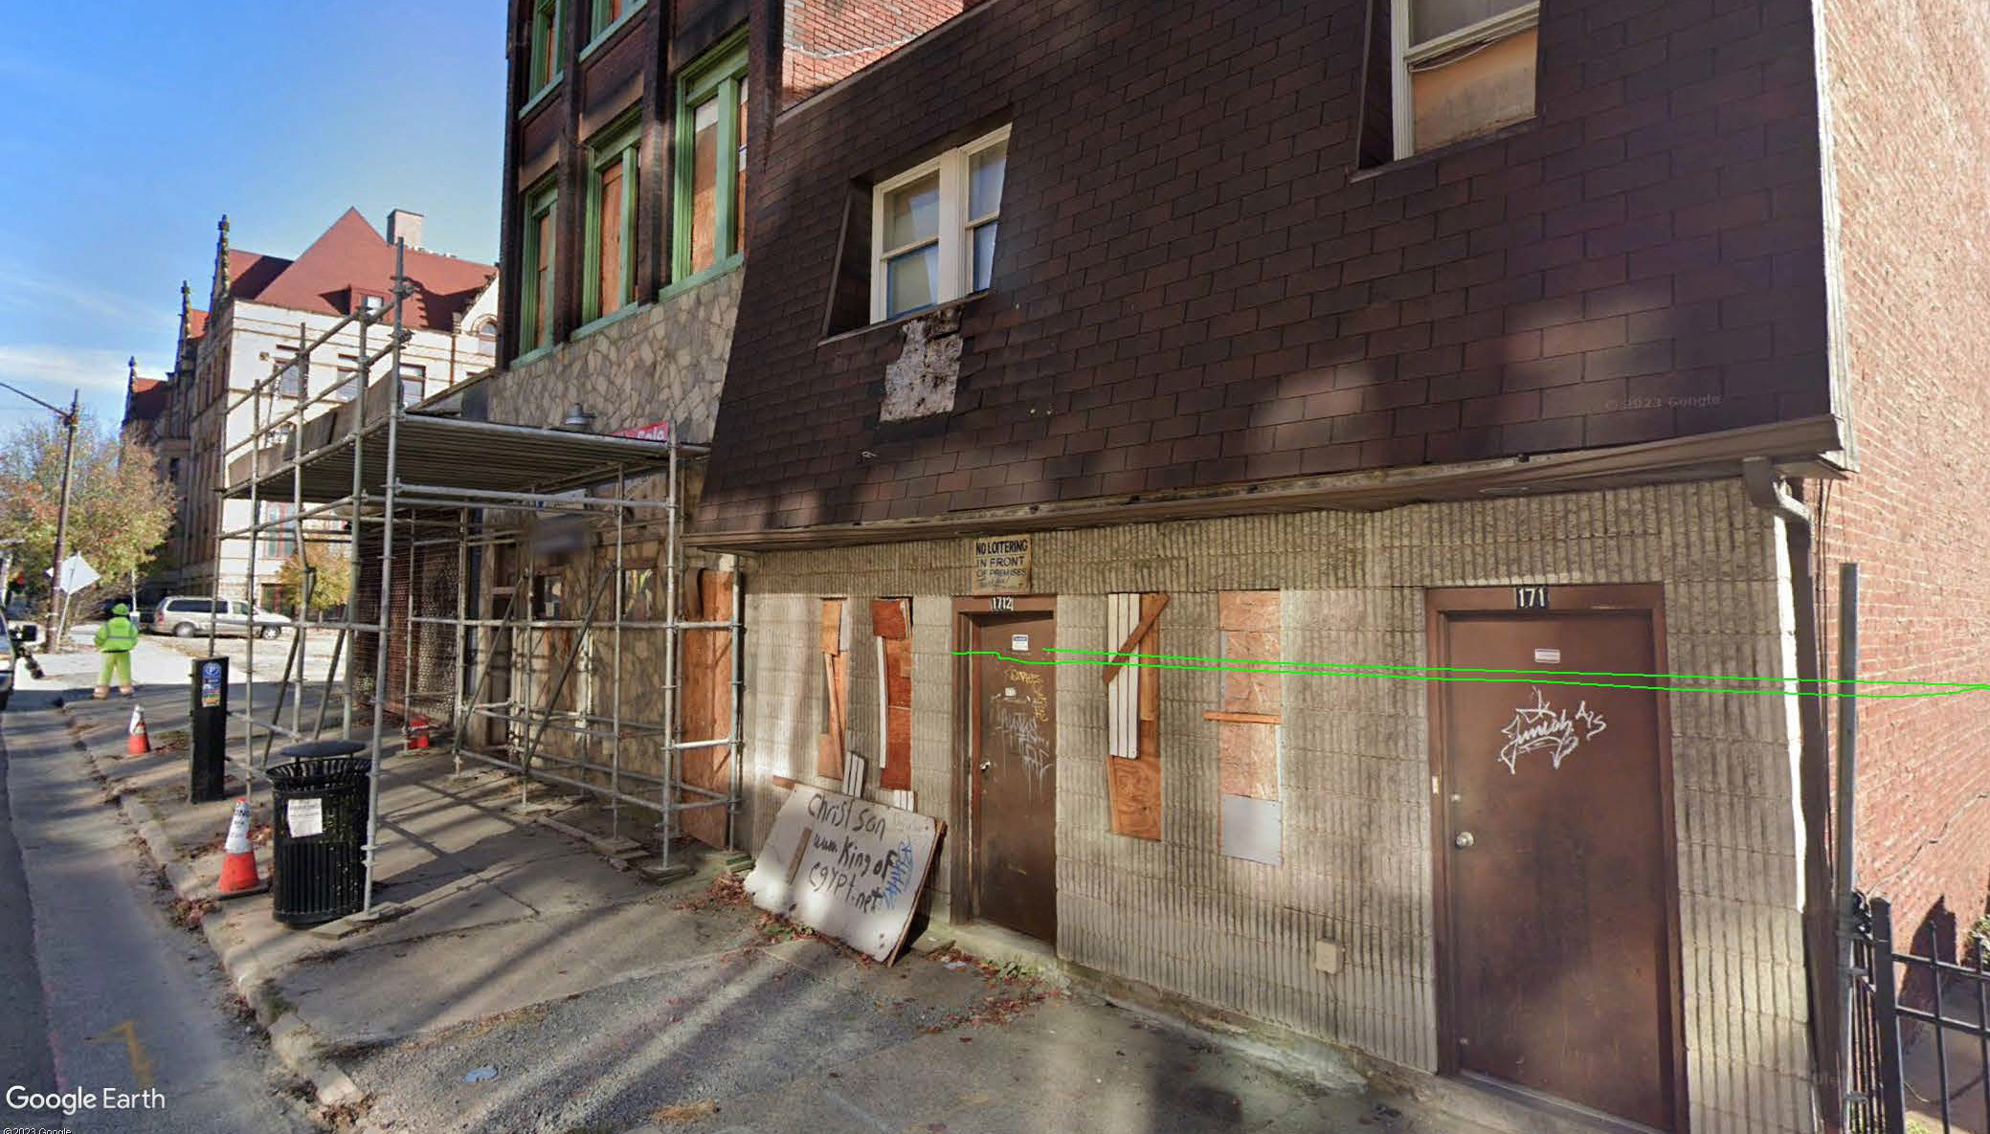
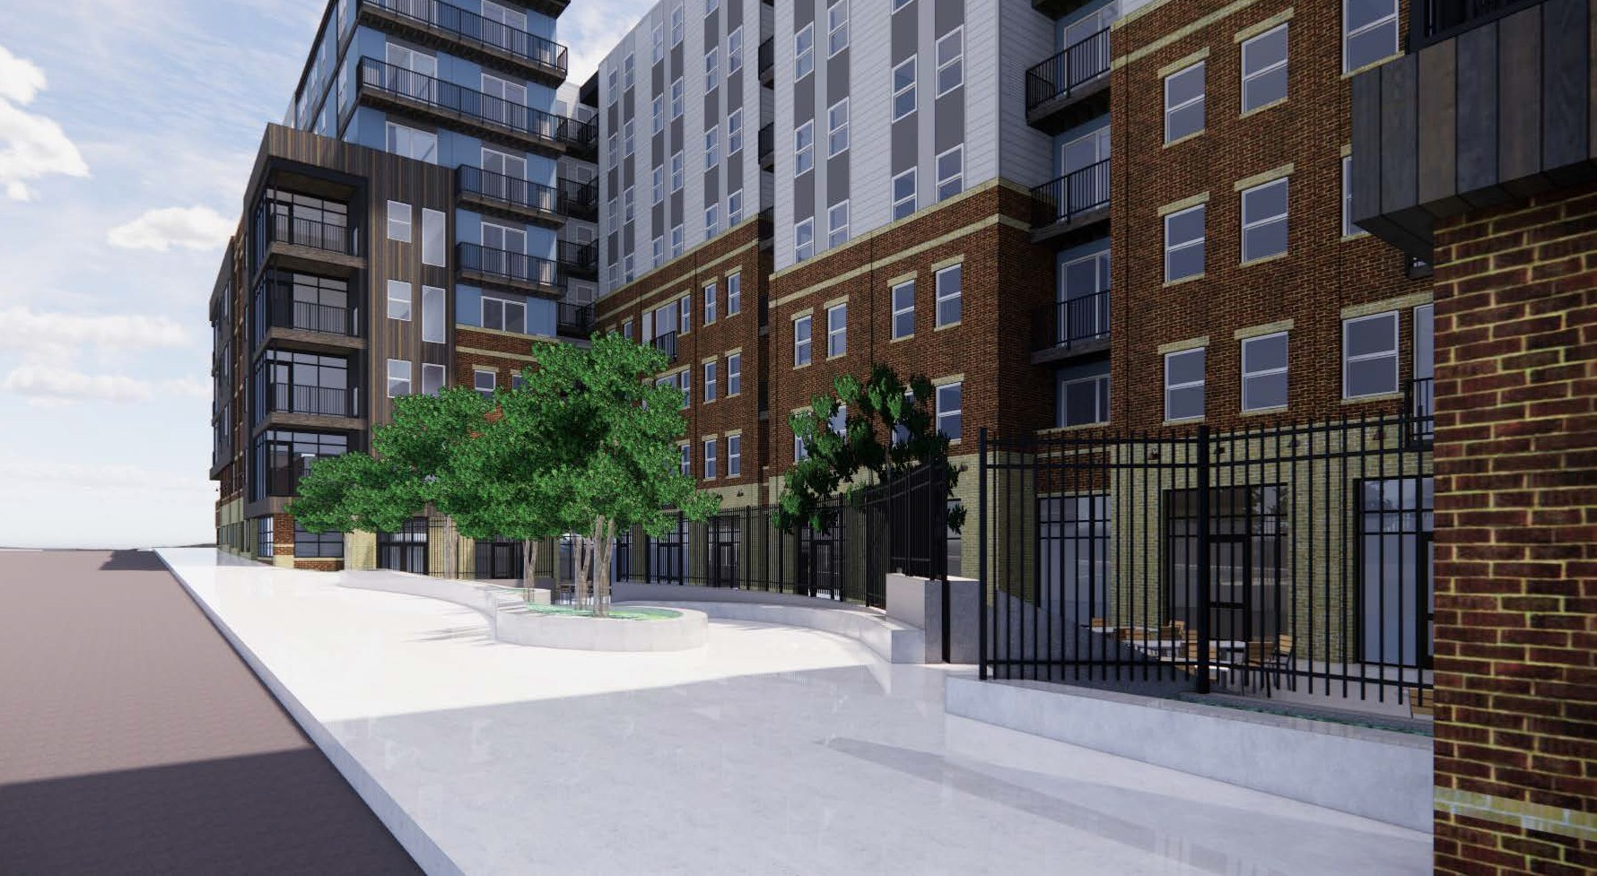
Existing
1700 FIFTH AVENUE
Future
CONFIDENTIAL

Slide 20
BENEFITS
CREATING THRIVING COMMUNITIES

Slide 21
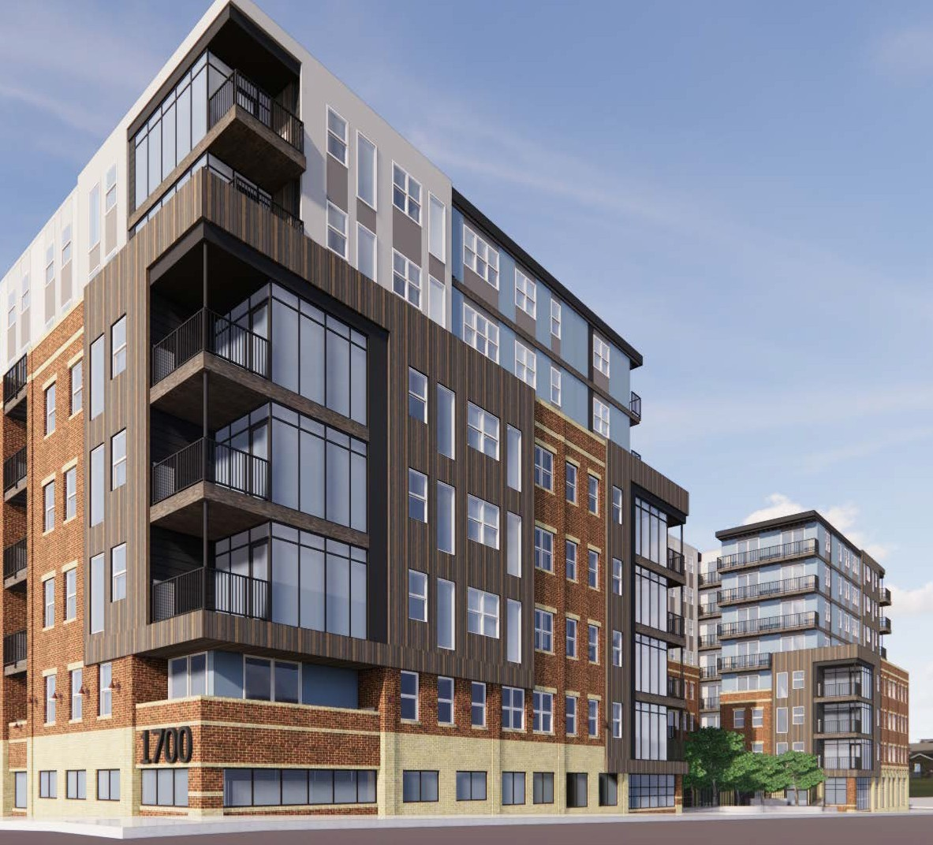
HOUSING AFFORDABILITY
240
Total apartment homes
24
10% of the property offered
at 50% AMI
6
2.5% of the property offered at 85% AMI
210
Apartment homes offered at
market rate
CONFIDENTIAL

Slide 22
DIVERSITY & COMMITMENT
Diverse Partnerships
While 18% minority and 6% women are local targets, Alpha Residential, in addition to being a certified MBE itself, will target 40% as a total of DBE involvement and prioritizes outreach to local entrepreneurs and enterprises for their participation in this project.
Our Commitment
We are committed to being a long term partner in this community with a minimum 10-year investment vs. a ‘Merchant’ Developer strategy (build-stabilize-exit).
CONFIDENTIAL

Slide 23
EDUCATION BENEFITS
Education-Based Board Members
Our founders are active board members of two education organizations – South Fayette Parent Teacher Association and The Education Partnership.
Volunteerism & Monetary Support
We are committed to education-based organizations such as Junior Achievement, Path to Possibilities, and various school districts.
Educating The Future Workforce
We provide annual internship opportunities to students from local Pittsburgh colleges and universities. There will be opportunities specific to this project relating to design, construction, development, and project management.
ENVIRONMENTAL BENEFITS
Eco-Innovation District Compliant
The project takes into consideration all aspects addressed within the Eco-Innovation District standards.
Sustainability & Enviornmentally Conscious
We are committed to adhering to top sustainability and wellness practices and will include materials and solutions that meet green environmental standards – striving for LEED Silver equivalent. We plan to have over 80 bike parking spaces, green roofing, low flow plumbing fixtures, LED lighting, electric vehicle charging stations, and even explore solar energy investments.
CONFIDENTIAL

Slide 24
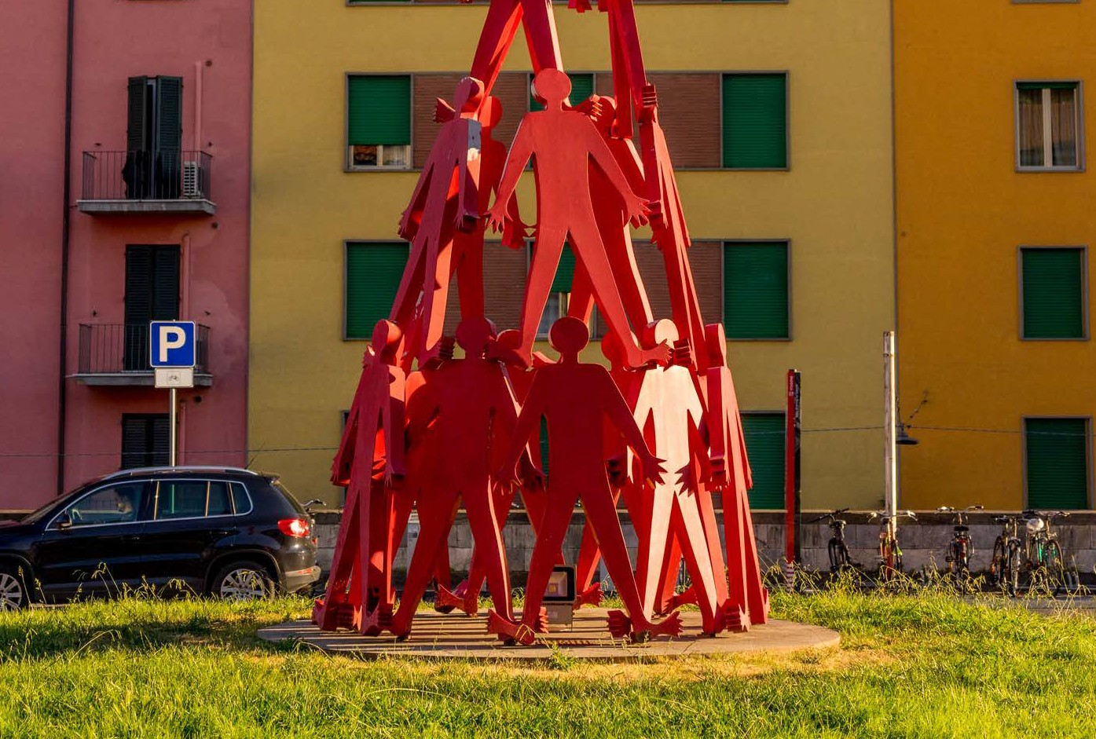
PROPOSED HEALTH BENEFITS
Fitness Center / Studio
(ex. Boxing Studio)
Smoothie Shop
(ex. Topical Smoothie)
Fast Casual Natural Foods
(ex. Choolah)
PROPOSED ARTS BENEFITS
Interior Artwork & Signage
Plaza Sculpture*
Interior display from Mixed-use into Plaza
CONFIDENTIAL

Slide 25
HEADQUARTERS
CONTACT US
DEVELOPMENT@ALPHARESIDENTIAL.COM
412.212.0665
44 Abele Road,
Beacon 1, Suite 304
Bridgeville, PA 15017
412.212.0665
JOSEPH JOHNSON
Managing Director, Development
724.495.9713
ALPHARESIDENTIAL.COM
CONFIDENTIAL
27

